Slide 1
Area Moment of Inertia of Composite Areas (P2)

Slide 2
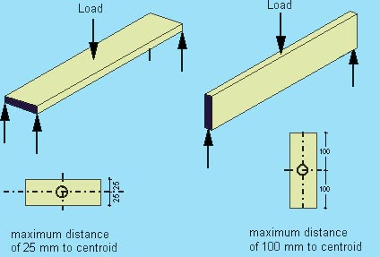
Introduction to the concept
Two simply supported beams shown
Which of the two bends more, the beam on the left or the one at the right?
Observe the rectangular shapes shown below. These are called the cross-sections of the beams
Also observe that the cross-sectional area (area of the rectangle) of both beams is the same. Only their orientations are changed

Slide 3

Recall Parallel Axes Theorem
$$I_{x}=I_{G}+Ad^{2}$$
$$I_{abt. any parallel ref. axis}=I_{abt. centroidal axis}+[Area×{\left(dist.bet. the two axes\right)}^{2}]$$

Slide 4
Determine MI of the T-section about its centroidal axis

Slide 5
Divide the composite into basic shapes and choose a reference axes system

Slide 6
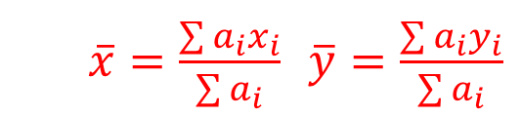
Determine the centroid of the composite with respect to the reference axes
$\overline{x}=\frac{\sum{a_{i}x_{i}}}{\sum{a_{i}}}$ $\overline{y}=\frac{\sum{a_{i}y_{i}}}{\sum{a_{i}}}$

Slide 7

MI of composite area
$$I_{composite}=\sum{I_{individual shapes}}$$

Slide 8

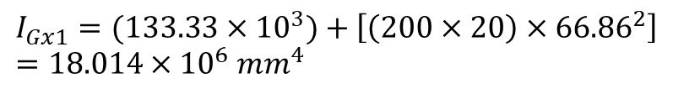

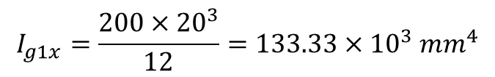
MI of individual shapes (rectangle a1) about the centroidal axis (G_{x})
$$I_{x}=I_{G}+Ad^{2}$$
$$I_{Gx1}=I_{g1x}+a_{1}d_{y1}^{2}$$
$$I_{g1x}=\frac{200×{20}^{3}}{12}=133.33×{10}^{3} {mm}^{4}$$
$$d_{y1}=y_{g1}+y_{G}=240−173.14=66.86 mm$$
$$I_{Gx1}=(133.33×{10}^{3})+\left[\left(200×20\right)×{66.86}^{2}\right]={18.014×10}^{6} {mm}^{4}$$

Slide 9

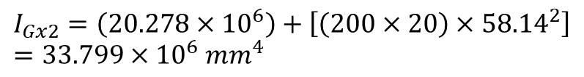
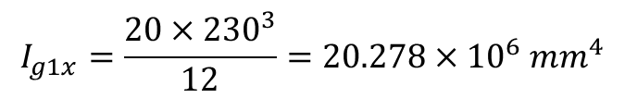

MI of individual shapes (rectangle a2) about the centroidal axis (G_{x})
$$I_{x}=I_{G}+Ad^{2}$$
$$I_{Gx2}=I_{g2x}+a_{2}d_{y2}^{2}$$
$$I_{g1x}=\frac{20×{230}^{3}}{12}=20.278×{10}^{6} {mm}^{4}$$
$$d_{y2}=y_{G}+y_{g2}=173.14−115=58.14 mm$$
$$I_{Gx2}=\left(20.278×{10}^{6}\right)+\left[\left(200×20\right)×{58.14}^{2}\right]={33.799×10}^{6} {mm}^{4}$$

Slide 10

MI of the composite (T-section) about the centroidal axis (G_{x})
$$I_{composite}=\sum{I_{individual shapes}}$$
$$I_{Gx}=I_{Gx1}+I_{Gx2}$$
$$I_{Gx}={(18.014×10}^{6})+{(33.799×10}^{6})=51.813×{10}^{6} {mm}^{4}$$

Slide 11


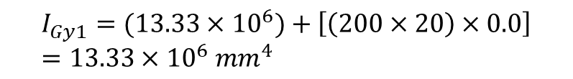

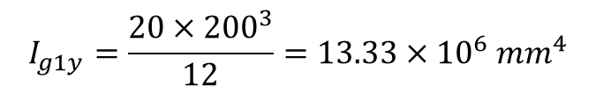
MI of individual shapes (rectangle a1) about the centroidal axis (G_{y})
$$I_{y}=I_{G}+Ad^{2}$$
$$I_{Gy1}=I_{g1y}+a_{1}d_{x1}^{2}$$
$$I_{g1y}=\frac{20×{200}^{3}}{12}=13.33×{10}^{6} {mm}^{4}$$
$$d_{x1}=x_{g1}+x_{G}=100−100=0.0 mm$$
$$I_{Gy1}=(13.33×{10}^{6})+\left[\left(200×20\right)×0.0\right]={13.33×10}^{6} {mm}^{4}$$

Slide 12

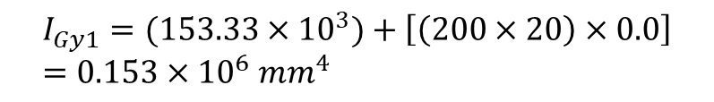

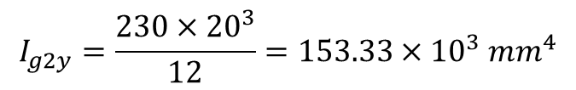
MI of individual shapes (rectangle a2) about the centroidal axis (G_{y})
$$I_{y}=I_{G}+Ad^{2}$$
$$I_{Gy2}=I_{g2y}+a_{1}d_{x2}^{2}$$
$$I_{g2y}=\frac{230×{20}^{3}}{12}=153.33×{10}^{3} {mm}^{4}$$
$$d_{x2}=x_{g2}+x_{G}=100−100=0.0 mm$$
$$I_{Gy1}=(153.33×{10}^{3})+\left[\left(200×20\right)×0.0\right]={0.153×10}^{6} {mm}^{4}$$

Slide 13
MI of the composite (T-section) about the centroidal axis (G_{x})
$$I_{composite}=\sum{I_{individual shapes}}$$
$$I_{Gy}=I_{Gy1}+I_{Gy2}$$
$$I_{Gy}={(13.33×10}^{6})+{(0.153×10}^{6})=13.483×{10}^{6} {mm}^{4}$$

Slide 14
Polar MI of the T-section
$$I_{Gz}=I_{Gx}+I_{Gy}$$
$$I_{Gz}=(51.813×{10}^{6})+{(13.483×10}^{6})=65.296×{10}^{6} {mm}^{4}$$

Slide 15
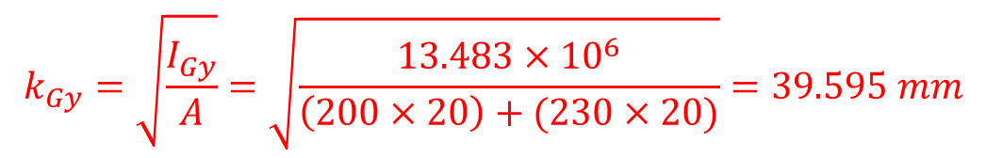
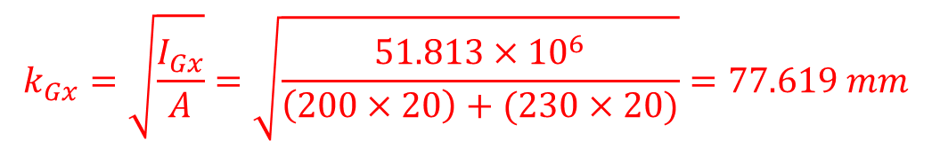
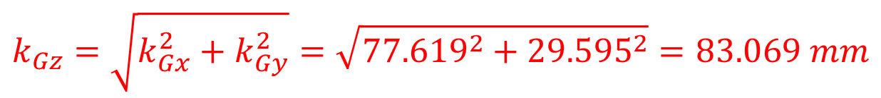
Radii of Gyration
$$k_{Gx}=\sqrt{\frac{I_{Gx}}{A}}=\sqrt{\frac{51.813×{10}^{6}}{\left(200×20\right)+(230×20)}}=77.619 mm$$
$$k_{Gy}=\sqrt{\frac{I_{Gy}}{A}}=\sqrt{\frac{13.483×{10}^{6}}{\left(200×20\right)+(230×20)}}=39.595 mm$$
$$k_{Gz}=\sqrt{k_{Gx}^{2}+k_{Gy}^{2}}=\sqrt{{77.619}^{2}+{29.595}^{2}}=83.069 mm$$

